Slide 1
A DISTRICT-LEVEL DATA STUDY
E-Waste in Uttarakhand:
The Hill-State Paradox
Dehradun
Mapping generation, collection gaps, and the road to formalization across 13 districts
state tile-map, schematic — positioned by real geography
Compiled from the Uttarakhand E-Waste Collection Log (illustrative district
workbook) and national CPCB / PIB e-waste data · 2025–26
Uttarakhand E-Waste Study · slide 1 of 6
Source: Uttarakhand E-Waste Collection Log (illustrative district workbook, 2025–26) & national CPCB/PIB e-waste data

Slide 2
THE TWO-SIDED PICTURE
The Hazard, and the Opportunity
THE HAZARD
THE OPPORTUNITY
• 33.7 lakh kg of e-waste generated statewide every year
• Only 43.4% is formally collected — the rest leaks into informal channels
• 3 of 7 monitored informal sites exceed safe Pb / Cd limits
• Hill districts collect under 40% of what they generate — infrastructure gap
• 27,600 t/yr of formal recycling capacity already installed
• 75.4% average material recovery rate at authorized recyclers
• 555 informal workers identified — a ready workforce for formalization
• 102 registered collection centres already exist to build on
Uttarakhand's e-waste problem isn't a lack of infrastructure — it's an uneven system where the plains process and the hills are left out.
Uttarakhand E-Waste Study · slide 2 of 6
Source: Uttarakhand E-Waste Collection Log (illustrative district workbook, 2025–26) & national CPCB/PIB e-waste data

Slide 3
GROWTH VS. CAPTURE
The State Tsunami
India's formal e-waste system is scaling fast — but Uttarakhand still loses more than half its e-waste to informal or unrecorded channels.
The Insight
India's formally collected & processed e-waste rose 43× in eight years — from 22,700 t (FY16–17) to 9,88,479 t (FY24–25).
Uttarakhand, 2025–26
33.7 lakh kg generated · only 43.4% formally collected · the remaining 56.6% is unaccounted for.
Uttarakhand E-Waste Study · slide 3 of 6
Source: Uttarakhand E-Waste Collection Log (illustrative district workbook, 2025–26) & national CPCB/PIB e-waste data

Slide 4
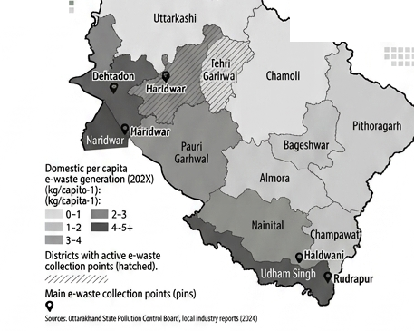
WHERE THE GAP SITS
The District Map
District boundaries reproduced from a supplied reference map — shading and figures below are our own, verified workbook numbers, not the map's original labels.
Real collection rate by district (from our workbook)
Dehradun
49.5%
Haridwar
45.8%
Udham Singh Nagar
43.8%
Nainital
43.4%
Almora
38.7%
Pauri Garhwal
37.1%
Tehri Garhwal
36.2%
Chamoli
32.2%
Pithoragarh
31.6%
Uttarkashi
31.8%
Champawat
30.9%
Bageshwar
30.0%
Rudraprayag
28.9%
Base map: district boundaries only — legend and per-capita values on the original graphic are unverified and not used here.
Uttarakhand E-Waste Study · slide 4 of 6
Source: Uttarakhand E-Waste Collection Log (illustrative district workbook, 2025–26) & national CPCB/PIB e-waste data

Slide 5
PLAINS VS. HILLS
Comparison Matrix: Collection Performance
Dehradun, Haridwar, Udham Singh Nagar & Nainital vs. the remaining nine hill districts
 | Plains Districts (4) | Hill Districts (9)
Avg. collection rate | 46.4% | 34.3%
Avg. per-capita generation | 0.41 kg/yr | 0.22 kg/yr
Registered collection centres | 67 | 35
Districts with an authorized recycler | 4 of 4 | 1 of 9
Installed recycling capacity | 27,200 t/yr | 400 t/yr
Share of state e-waste generated | 75.1% | 24.9%
The hills generate a quarter of the state's e-waste but hold almost none of its formal capacity to handle it.
Uttarakhand E-Waste Study · slide 5 of 6
Source: Uttarakhand E-Waste Collection Log (illustrative district workbook, 2025–26) & national CPCB/PIB e-waste data

Slide 6
WHAT COMES NEXT
Roadmap to a District-Balanced Solution
Three steps, grounded in what the data already shows is working and what isn't
1
Formalize & Protect
Bring the 555 identified informal workers into registration and training, starting with the 3 already-partially-formalized clusters (Patel Nagar, Kashipur, Jwalapur) before tackling the 4 still fully informal.
2
Finance & Build
Extend recycler capacity beyond the 5 hub districts. Prioritize the 8 hill districts with zero authorized recyclers, using Uttarkashi's single small unit as the proof of concept.
3
Enforce & Innovate
Raise Regulatory Compliance (9.0/15) and Collection Performance (8.7/20) — the two weakest of the 7 scorecard categories — by closing the plains-to-hills centre gap (67 vs. 35).
Sustainable, district-balanced e-waste infrastructure is the cornerstone for turning Uttarakhand's hill-state paradox into a hill-state model.
Uttarakhand E-Waste Study · slide 6 of 6
Source: Uttarakhand E-Waste Collection Log (illustrative district workbook, 2025–26) & national CPCB/PIB e-waste data

